Slide 1
Trello Clone Application
Object-Oriented Design Project, Fall 2023
Pranitha Mendonsa
Saurabh Agrawal
Shubham Gurav
SUID: 592029514
SUID: 296051296
SUID: 273280326

Slide 2
Introduction
Trello Clone: Enhancing Task Management
Signiﬁcance:
Digital transformation of project management
Streamlines task tracking processes
Facilitates eﬃcient and eﬀective team collaboration
Motivation:
To address the limitations of traditional project management tools
To provide insight-driven task management and user activity tracking

Slide 3

Project Overview and System Architecture
Controllers:
TaskController: Task Operations
UserController: User Operations
Services:
TaskService: Business Logic for Tasks
UserService: Business Logic for Users
Repositories:
TaskRepository, UserRepository:
Helpers Entities:
Task, User: Data Models

Slide 4
Task Controller
Methods –
/get - get the task body of a particular taskID
/getAll - getAll shows Board, return list of all tasks in order of TODO --> DOING --> DONE
/add - add a task with taskname and description, taskid increments and user=NULL,saves time of creation ,default status --> TODO
/modify - given the taskid, modify the task and updated time of task is set to current timestamp can change the assigned users,change status,add comment and edit description
/delete - deletes the task with particular task id, return Success/Failure
/getHistory - given the taskID, returns the list of history of modifications on task

Slide 5
User Controller
Methods:-
/get -returns the user details of particular userID
/getAll - returns the list of all users
/add - add the user, can pass the taskid to assign user to particular task
/delete - given the userid, deletes the user

Slide 6

Project Overview
Features and Functionality:
Task management (Create, Modify, Delete)
User Management (Add, Retrieve)
State Tracking (TODO, DOING, DONE)
Tech Stack:
Spring Boot
Java,
Spring Data JPA,
MySQL

Slide 7
Modularization
Sensible Class Definition
  Task
  TaskComment
  TaskHistoryTable
  TaskUsers
  UserDetails
2. Organizing classes in package/folders
  Package:- TrelloClone
  TrelloClone -> Controller
  TrelloClone -> Model -> Entity
  TrelloClone -> Model -> Task
  TrelloClone -> Repository
  TrelloClone -> Service
3. Coding to Interface
  TaskService - TaskSeviceImpl
  UserService – UserServiceImpl
  TaskRepository
  TaskCommentRepository

Slide 8

Design & Structure
1.Encapsulation
Task Service – Get, Set, Estimated Time to Complete
2. Inheritance
TaskCommentRepository has inherited JpaRepository
TaskHistoryTable has inherited JpaRepository
TaskRepository has inherited JpaRepository
TaskRepository has inherited JpaRepository
UserRepository has inherited JpaRepository
3. Composition
TaskResponse

Slide 9

Language Capabilities
1. Enums
TaskStatus – To-Do, Doing, Done
2. Interfaces/ Abstract/ Classes
TaskCommentRepository -Adding comment to the task
TaskHistoryTableRepository-Saving Task History and accessing task history by taskid,
TaskRepository- Saving Task by Taskid
TaskUsersRepository- User linking and access,
UserRepository- Storing and accessing User detail
TaskService - TaskSeviceImpl
UserService – UserServiceImpl

Slide 10

Readability & Clarity
Naming
  Meaningful names
  Use of camel casing
Consistency
  Naming conventions
  Indentations
  Comments and javadocs

Slide 11

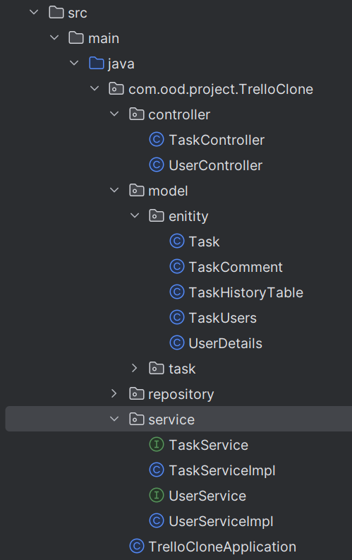
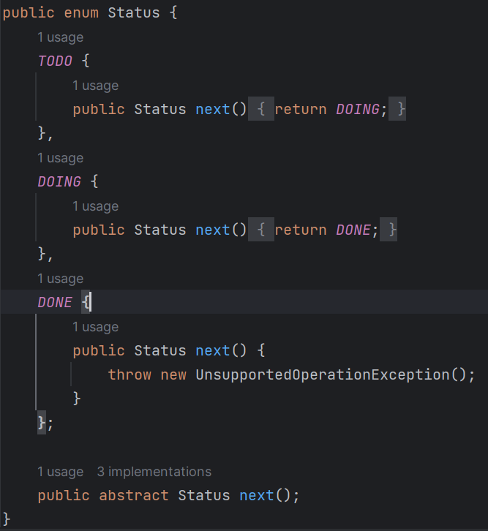
Design Patterns
MVC
FINITE STATE MACHINE

Slide 12
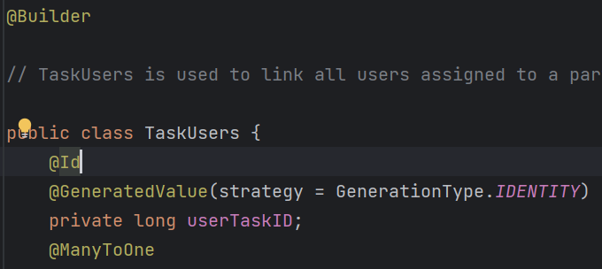
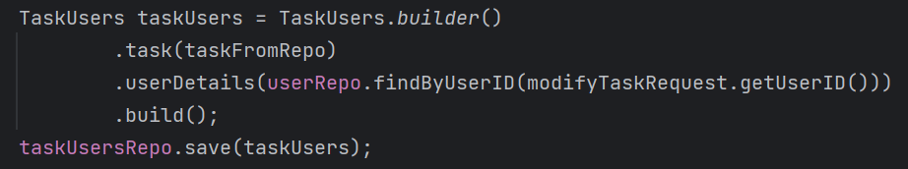
Design Patterns
Builder
SINGLETON

Slide 13
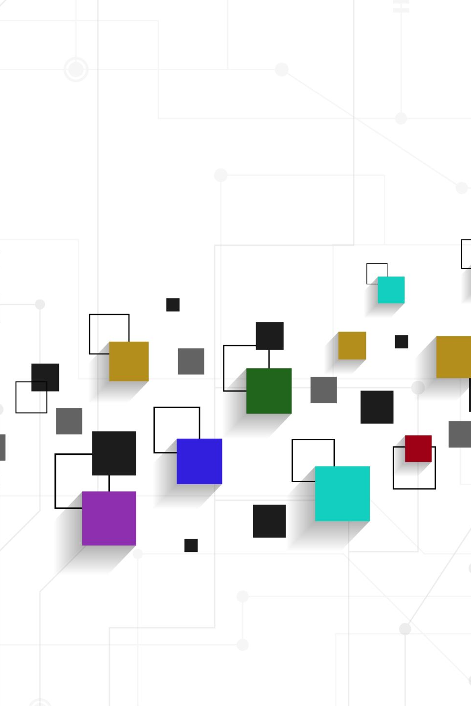
Challenges and Solutions
Challenges Encountered:
Time Tracking Complexity
Data Validation
Strategies for Overcoming Challenges:
Utilization of Java Time APIs for State Transitions
Using Lombok for Data Validation

Slide 14

Future Enhancements
Planned Additions:
Supporting multiple boards
Linking tasks with various dependencies
User authentication and authorization
Reporting and Analytics
Error handling
Addition of filters to narrow down the task list

